Slide 1

Heart health analysis
Silver Swords

Slide 2
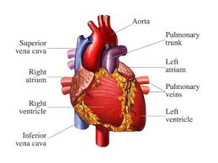
Introduction
A human heart is an organ that pumps blood throughout the body via circulatory system, supplying oxygen and nutrients to the tissues and removing carbon dioxide(CO2) and other wastes.
If the heart stops pumping the blood then there will be lakh of oxygen supply to all other organs of our body. Human heart is divided into four chambers: they are Right atrium, Left atrium, Right ventricle, Left ventricle.

Slide 3
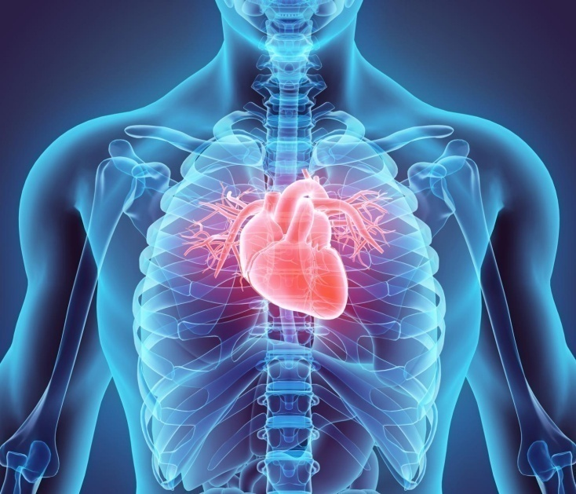
Functioning of heart
Generally blood enters the heart through two veins named superior vena cava and inferior vena cava. Through these veins blood enters the Right atrium of the heart. Next the blood flows from Right atrium to Right ventricle via open tricuspid valve . Next the blood enters the pulmonary artery via pulmonary valve which produces oxygenated blood. Now the blood flows to left artery through pulmonary veins and finally reaches the left ventricle via open mitral. Here the blood gets purifies and enters into the body through aorta valve. If the above process get altered then different heart disease occur.

Slide 4
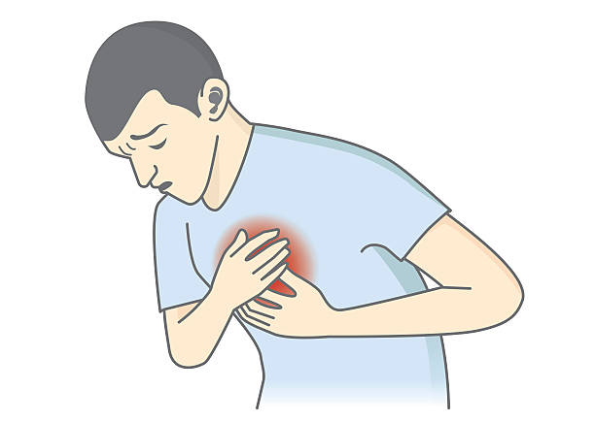
Among these diseases one of the heart disease is anginal heart disease. This disease depends on several parameters. They are :
CP(chest pain) : This condition is an inflammation or irritation of the lining of the lungs and chest . The most common causes of pleuritic chest pain are bacterial or viral infections, pulmonary embolism, and pneumothorax. There are four types of chest pain related to angina disease. They are :
Asymptomatic cp: It is a general chest pain without any symptoms. It does not lead to any heart disease.
Non anginal pain: It increases with inspiration. It can be brought with movement of trunk or arm , by local fingers pressure, bending fingers forward and backward (or) by lying down.
Atypical angina: Pain in the chest which is not cardiac pain , it is not related to heart but may lead to heart disease. It does not give any burning sensation.
Typical angina: In this type of chest pain the heart does not get enough blood or oxygen. It gives substernal chest pain.
Trestbps: It is nothing but resting blood pressure. It is measured in millimetre of mercury (mm Hg). This pressure when heart get relaxed should be around 80 mm Hg diastolic and 120 mm Hg systolic. There will be 60 to 100 beats per minute(bps).
Chol(cholesterol): It is serum cholestoral in mg/dl. Here the measurement is in milligram per decilitre
FBS: It is nothing but fasting blood pressure which is measured in milligrams per decilitre. If fbs> 120mm/dl then id is considered as high else it is considered as low.
Restecg: It is resting electrocardiographic results. It is of three types
normal
having ST-T
hypertrophy

Slide 5
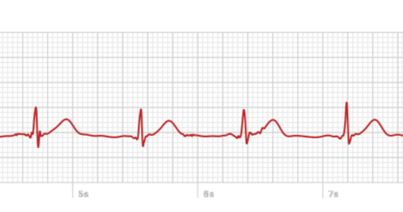
Thalach: It is the maximum heart rate achieved. Hence it is a numerical data.
Exang:The pain caused due to performing excersices.
Oldpeak:ST depression induced by exercise relative to rest.
Slope: the slope of the peak exercise ST segment.
Upsloping
flat
Downsloping
CP:number of major vessels (0-3) coloured by flourosopy.
Thal:
Normal
fixed defect
reversable defect
Target: It defines weather a person gets anginal heart disease or not.

Slide 6

Exploratory data analysis
Exploratory data analysis (EDA) is an approach to analyzing data sets to summarize their main characteristics, often with visual methods. A statistical model can be used or not, but primarily EDA is for seeing what the data can tell us beyond the formal modeling or hypothesis testing task.
Typical graphical techniques used in EDA are:
Box plot
Histogram
Multi-vari chart
Run chart
Pareto chart
Scatter plot

Slide 7
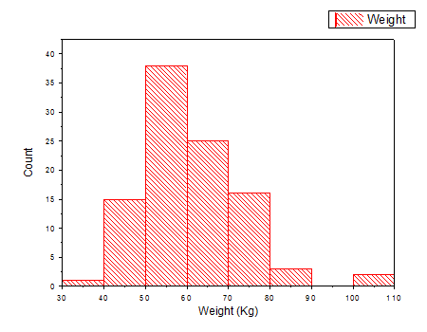
histogram
A histogram is an accurate representation of the distribution of numerical data.
Purpose of histogram is To roughly assess the probability distribution of a given variable by depicting the frequencies of observations occurring in certain ranges of values.

Slide 8
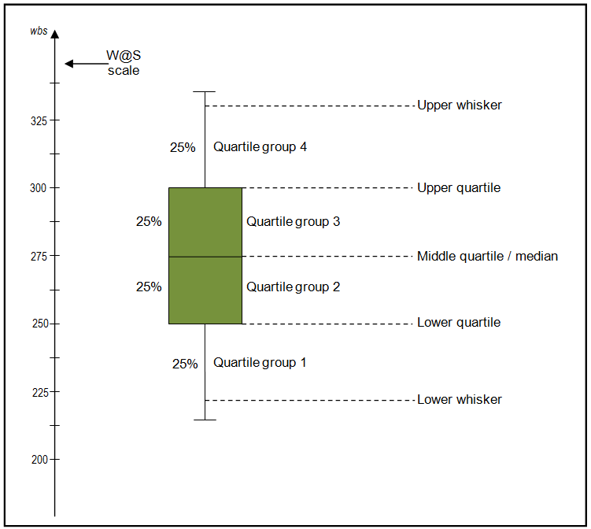
Box plot
a box plot or boxplot is a method for graphically depicting groups of numerical data through their quartiles. Box plots may also have lines extending vertically from the boxes (whiskers) indicating variability outside the upper and lower quartiles
Outliers may be plotted as individual points.

Slide 9
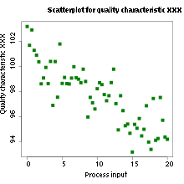
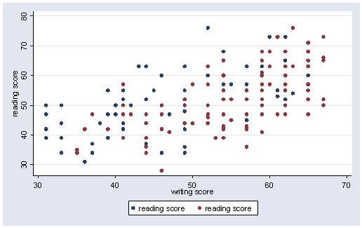
Scattered plot
A scatter plot is a two-dimensional data visualization that uses dots to represent the values obtained for two different variables - one plotted along the x-axis and the other plotted along the y-axis

Slide 10
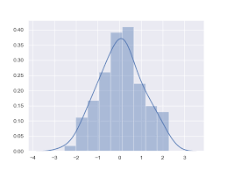
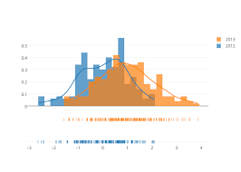
Density plot
A Density Plot visualises the distribution of data over a continuous interval or time period. This chart is a variation of a Histogram that uses kernel smoothing to plot values, allowing for smoother distributions by smoothing out the noise. The peaks of a Density Plot help display where values are concentrated over the interval.

Slide 11
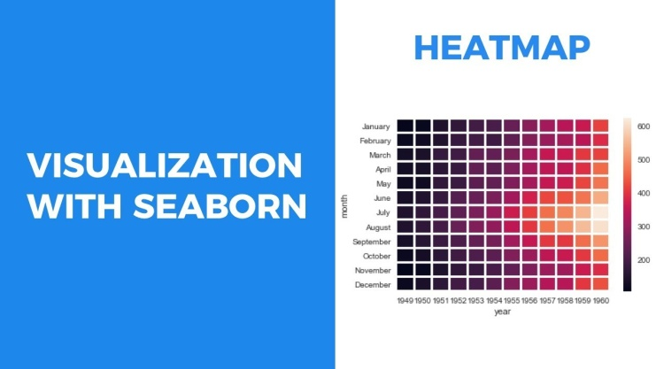
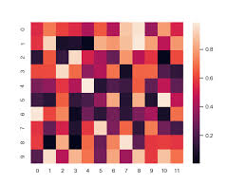
Heat map
a representation of data in the form of a map or diagram in which data values are represented as colours.
an image or map representing the varying temperature or infrared radiation recorded over an area or during a period of time.
This shows the relation between two different
Input variables or features

Slide 12
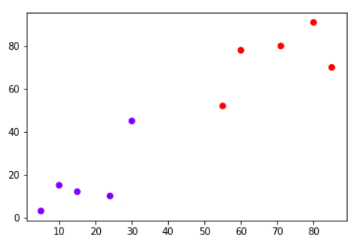
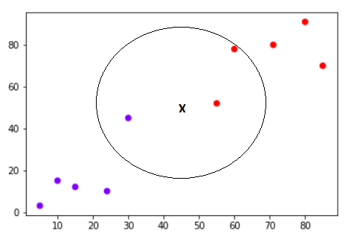
Knn model
The K-nearest neighbors (KNN) algorithm is a type of supervised machine learning algorithms. KNN is extremely easy to implement in its most basic form, and yet performs quite complex classification tasks. It is a lazy learning algorithm since it doesn't have a specialized training phase. Rather, it uses all of the data for training while classifying a new data point or instance. KNN is a non-parametric learning algorithm, which means that it doesn't assume anything about the underlying data. This is an extremely useful feature since most of the real world data doesn't really follow any theoretical assumption

Slide 13
Knn in model
Model number | Features | Accuracy score
1 | Age ,sex, cp, trestbps, chol fbs, restecg, thalach, exang Oldpeak, slope ca, Thal | 59.01
2 | Age, trestbps Chol, Thalach oldpeak | 59.04
3 | sex,fbs,restegc,exang,cp,slope,ca,thal | 81
4 | age,cp,thalach,chol,restecg | 83.26

Slide 14
Visualising the probability
In KNN classification the output is classified based on the nearest values to inputs,so it’s not accurate all the times.So predicting the output based the probabilities gives the more accurate results.In visualizing the probability graph it show a graph between the probality and the instances of occurance of the labels.

Slide 15
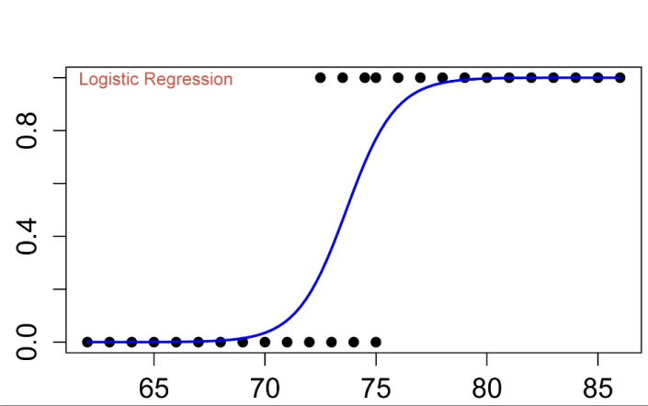
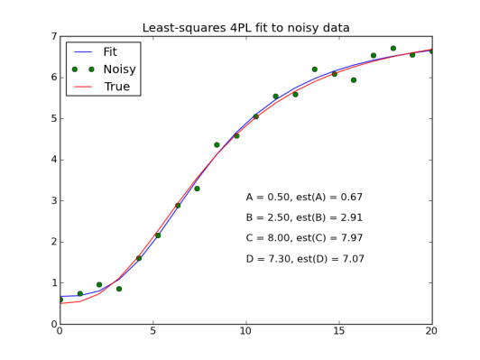
Logistic regression
Logistic Regression is one of the most simple and commonly used Machine Learning algorithms for two-class classification. It is easy to implement and can be used as the baseline for any binary classification problem. Its basic fundamental concepts are also constructive in deep learning. Logistic regression describes and estimates the relationship between one dependent binary variable and independent variables.
Logistic Regression can be used for various classification problems such as spam detection. Diabetes prediction, if a given customer will purchase a particular product or will they churn another competitor, whether the user will click on a given advertisement link or not, and many more examples are in the bucket.

Slide 16
Logistic regression in hha
Model number | Features | Accuracy score
1 | Age ,sex, cp, trestbps, chol fbs, restecg, thalach, exang Oldpeak, slope ca, Thal | 85.24
2 | Age, trestbps Chol, Thalach oldpeak | 73.77
3 | sex,fbs,restegc,exang,cp,slope,ca,thal | 80.32
4 | age,cp,thalach,chol,restecg | 77.04

Slide 17
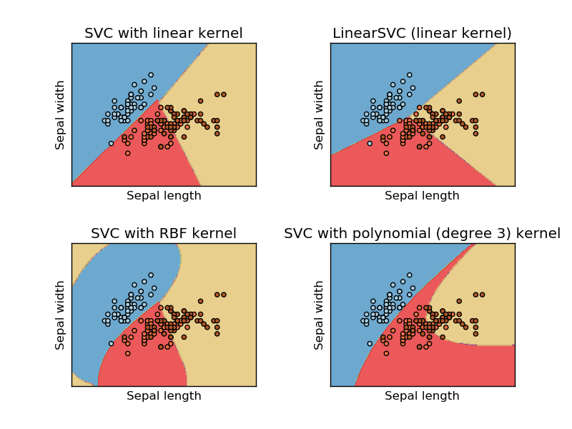
Support vector classificationl
The most applicable machine learning algorithm for our problem is SVC. Before hopping into SVC with our data,.
The objective of a SVC (Support Vector Classifier) is to fit to the data you provide, returning a "best fit" hyperplane that divides, or categorizes, your data. From there, after getting the hyperplane, you can then feed some features to your classifier to see what the "predicted" class is. This makes this specific algorithm rather suitable for our uses, though you can use this for many situations.

Slide 18
Svc in hha
Model no | Features | Accuracy
1 | Age ,sex, cp, trestbps, chol fbs, restecg, thalach, exang Oldpeak, slope ca, Thal | 50.07
2 | Age, trestbps Chol, Thalach oldpeak | 71.87
3 | sex,fbs,restegc,exang,cp,slope,ca,thal | 55.73
4 | age,cp,thalach,chol,restecg | 49.81

Slide 19
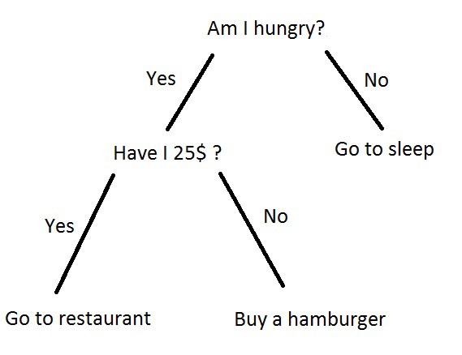
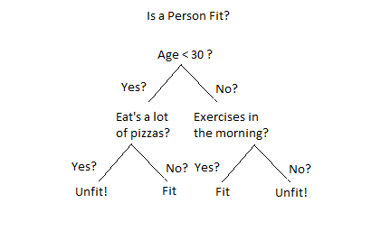
Decision tree
Decision Trees are a type of Supervised Machine Learning (that is you explain what the input is and what the corresponding output is in the training data) where the data is continuously split according to a certain parameter. The tree can be explained by two entities, namely decision nodes and leaves. The leaves are the decisions or the final outcomes. And the decision nodes are where the data is split.

Slide 20
Decision tree in HHA
Model number | Features | Accuracy
1 | Age ,sex, cp, trestbps, chol fbs, restecg, thalach, exang Oldpeak, slope ca, Thal | 81.9
2 | Age, trestbps Chol, Thalach oldpeak | 59.02
3 | sex,fbs,restegc,exang,cp,slope,ca,thal | 80.32
4 | age,cp,thalach,chol,restecg | 65.57

Slide 21
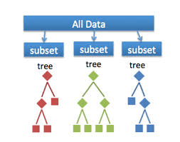
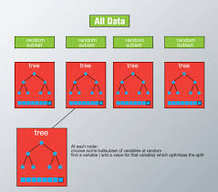
Random forest
Random Forest is a flexible, easy to use machine learning algorithm that produces, even without hyper-parameter tuning, a great result most of the time. It is also one of the most used algorithms, because it’s simplicity and the fact that it can be used for both classification and regression tasks. In this post, you are going to learn, how the random forest algorithm works and several other important things about it.

Slide 22
Random forest in HHA
Model number | Features | Accuracy
1 | Age ,sex, cp, trestbps, chol fbs, restecg, thalach, exang Oldpeak, slope ca, Thal | 85.24
2 | Age, trestbps Chol, Thalach oldpeak | 80.97
 | sex,fbs,restegc,exang,cp,slope,ca,thal | 82.33
 | age,cp,thalach,chol,restecg | 76.71

Slide 23

Accuracy chart
KNN Model | 1 all input parameters 2 categorical features 3 numerical features 4 explored features | 64.54% 81% 59.04% 83.24%
Logistic Regression | 1 all input parameters 2 categorical features 3 numerical features 4 explored features | 85.24% 80.32% 73.77% 77.04%
Support Vector Classification | 1 all input parameters 2 categorical features 3 numerical features 4 explored features | 50.07% 85.73% 71.87% 49.81%
Decision Tree Classifier | 1 all input parameters 2 categorical features 3 numerical features 4 explored features | 80.32% 82.68% 62.29% 70.49%
Random Forest Classifier | 1 all input parameters 2 categorical features 3 numerical features 4 explored features | 89% 82.33% 80.97% 76.71%

Slide 24
Summary
Finally after the analysis of the given data we found that the Random Forest Classifier with all input parameters have highest accuracy among all the models formed from first to last.

Slide 25
presented to you by team silver swords :
--VIDHUR.K
--SUKEERTHI.S
--LAKSHMI.D
--SOURAV.P
--AISHWARYA.K

